Slide 1
Algorithms for the Visualization and Simulation of Mobile Ad Hoc and Cognitive Networks
Dan Hennessey

Slide 2
Outline
Introduction
Network Visualization
Graph Simplification
GPU base Cognitive Networking Algorithms
Conclusions
Questions

Slide 3
Introduction
Visualization and Simulation important
Clearer understanding of functionality
Better evaluate performance
Mobile Ad Hoc Network Visualization
Visualization of Complex Graph Structures
GPU Based Spectrum Sensing Algorithms

Slide 4
Algorithms for Mobile Ad Hoc Network Visualization
Chapter 1

Slide 5
Mobile Ad Hoc Networks
Simulation is complex
Visualization improves understanding
Limited work visualizing MANET’s
Inclusion of terrain adds a level of realism
No work done visualizing terrain with MANET’s

Slide 6
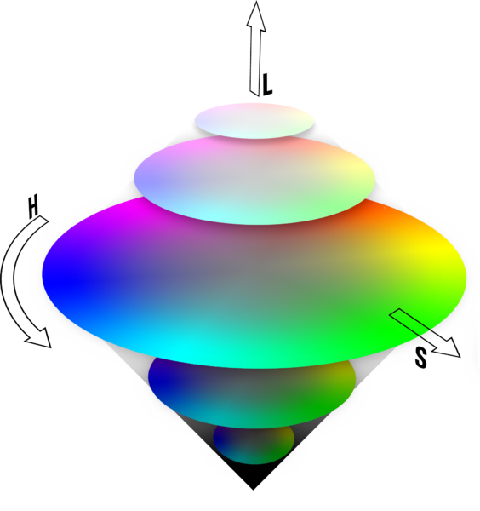
Signal Radiation Patterns
Visualization of the physical layer
Transmitter signal patterns
Accounts for environment variables
Visualize effects of channel state
Known vs. unknown
Regions of acceptable SINR
Map signal strength to HSL color model
Integrated into OMAN

Slide 7
Radiation Patterns
Fully known channel state
Highly unstable channel state

Slide 8
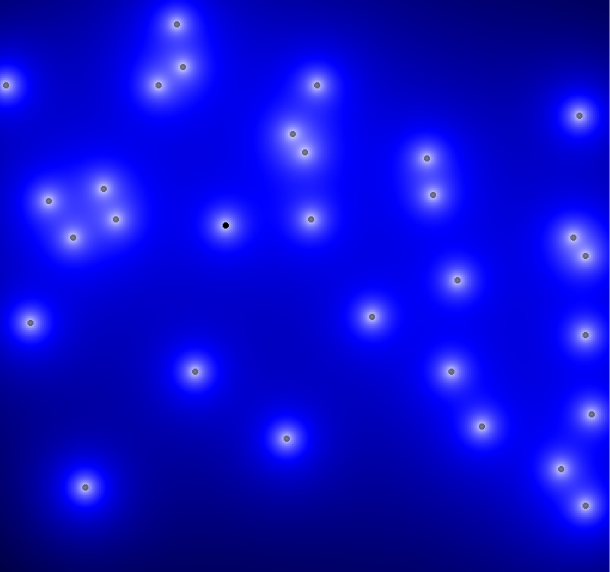
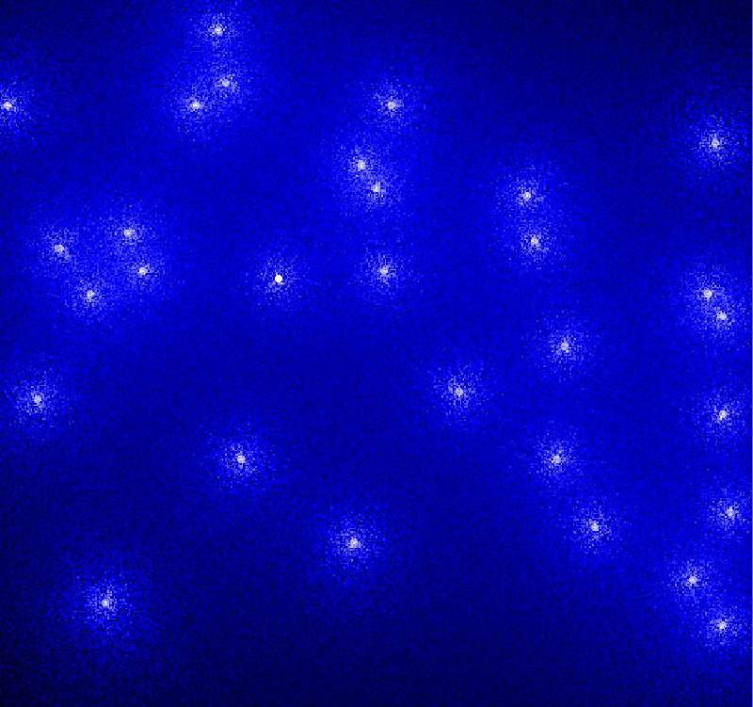
Radiation Patterns
Fully known channel state
Highly unstable channel state

Slide 9
Radiation Patterns with Regions of Acceptable SINR
Fully known channel state
Highly unstable channel state

Slide 10
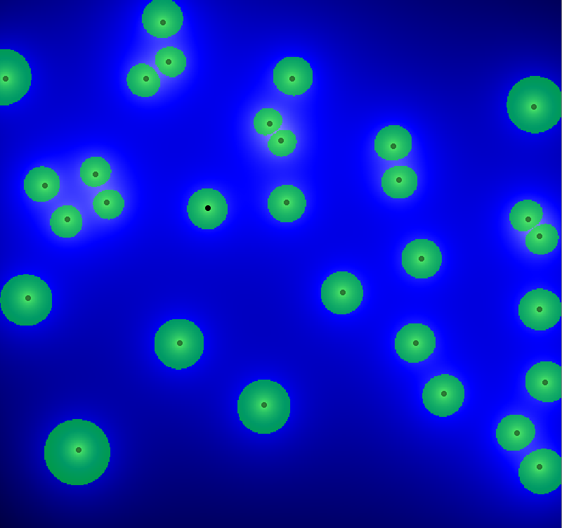
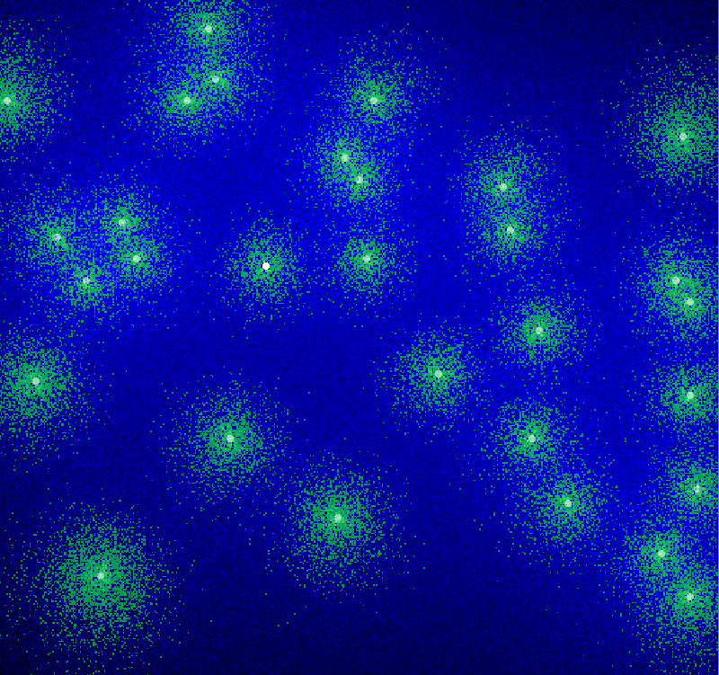
Radiation Patterns with Regions of Acceptable SINR
Fully known channel state
Highly unstable channel state

Slide 11
Digital Terrain
Adds level of realism to simulations
Enhances simulation of wave propagation models
Can do the same for visualizations
Drawbacks
Multiple file formats
Deal with file boundaries
Fixed resolution data

Slide 12
Terrain Library
Terrain Library features
Abstracts away file format specifics
Removes file boundaries

Slide 13
Terrain Library
Desired region

Slide 14
Terrain Library
Terrain Library features
Abstracts away file format specifics
Removes file boundaries
Data interpolation
Lake detection
Horizontal and Vertical cut profiles

Slide 15
Lake Detection and Cut Profiles

Slide 16
Terrain Library
Terrain Library features
Abstracts away file format specifics
Removes file boundaries
Data interpolation
Lake detection
Horizontal and Vertical cut profiles
Provides 2D and 3D visualization capabilities
Variety of color maps

Slide 17
Terrain Color Maps

Slide 18
Integration with OMAN
Terrain Library integrated with OMAN
Data used in simulation
Optional use in visualization
Introduced 3D visualization into OMAN

Slide 19
2D Terrain Visualization
Flow Graph
Physical Graph

Slide 20
3D Terrain Visualization

Slide 21
3D Terrain Visualization

Slide 22
Conclusion
Visualization of signal radiation patterns
Defined a terrain library
Showed benefits of visualizing terrain with simulated MANET’s
Future Work
Visualization for other layers
Integration of visualizations
Increased interactivity with visualizations

Slide 23
A Simplification Algorithm for Visualizing the Structure of Complex Graphs
Chapter 2

Slide 24
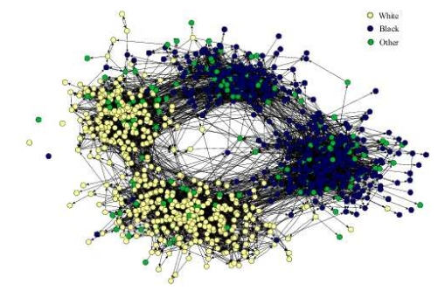
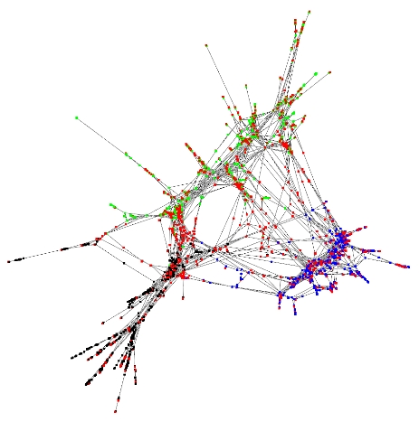
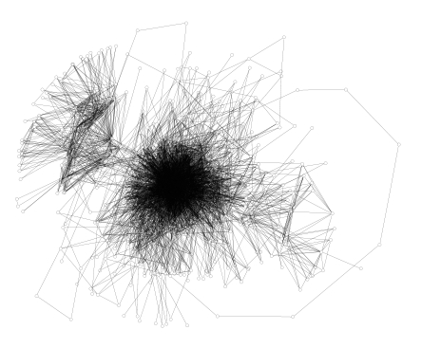
Complex Graphs
Notes:
24

Slide 25
Algorithm Overview
Node weighting
N-ring Neighbors
Number of Shortest Paths
Eccentricity
Shortest Distance to a Center Node
Shortest Distance to a Leaf Node
Node Pruning
Connectivity Preservation
Iterative Pruning
Notes:
25

Slide 26
Performance Criteria
3 Performance Criteria
Wide range of weight values
Even distribution of weights
Meaningful visual representation
Notes:
26

Slide 27
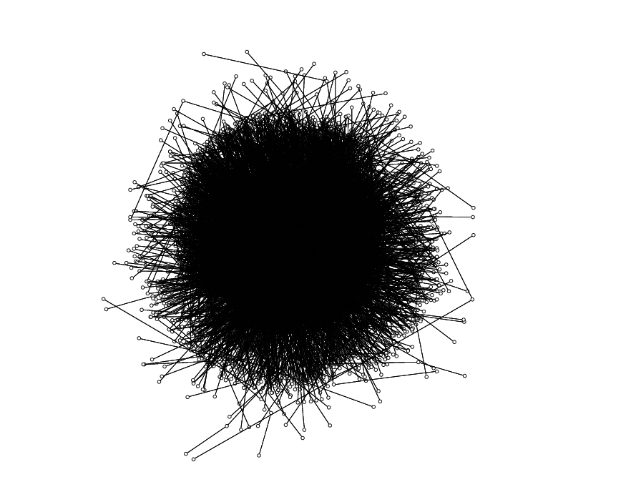
Test Data: Inet Graph
4500 Nodes
15308 Edges
Simulated internet topology
Power-law based generation
Notes:
27

Slide 28
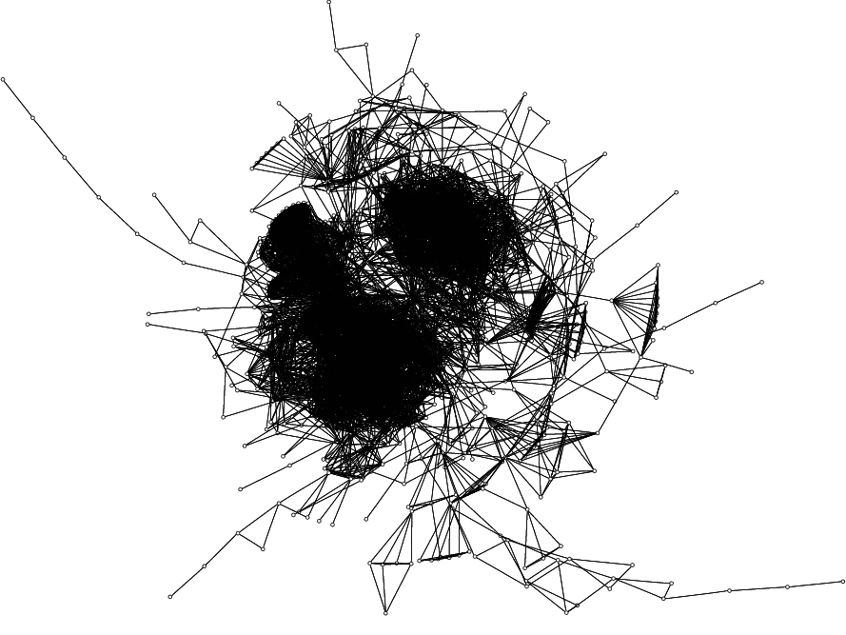
Test Data: Citation Graph
1025 Nodes
15430 Edges
Research citation trends
Provided by Dr. Chaomei Chen
Notes:
28

Slide 29
N-ring Neighbors
Notes:
29

Slide 30
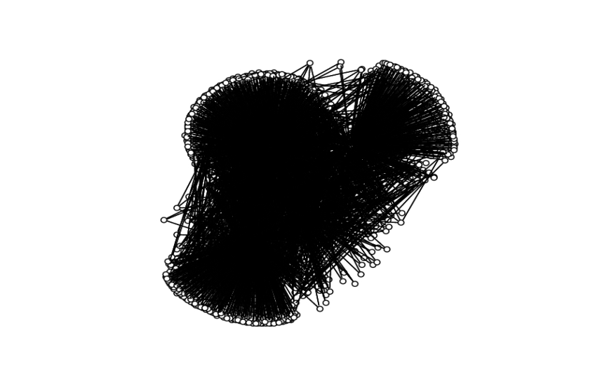
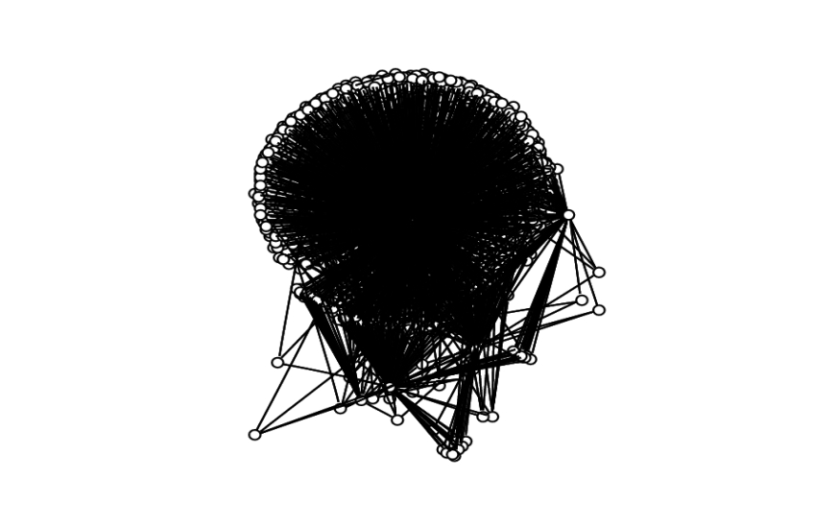
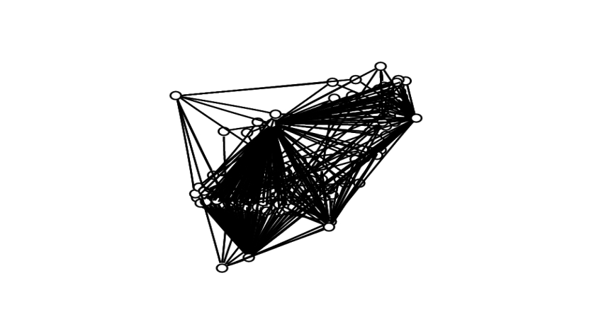
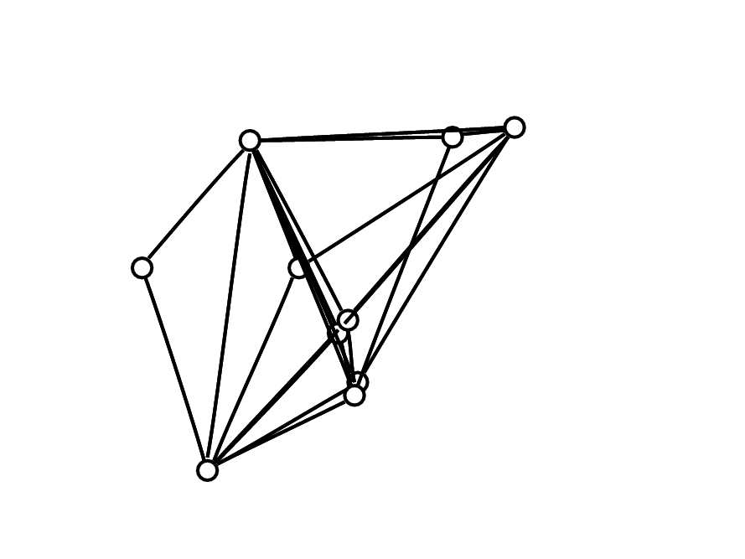
Inet Graph: 2-ring Neighbors
T = 300
T = 700
T = 1200
T = 1800
Notes:
30

Slide 31
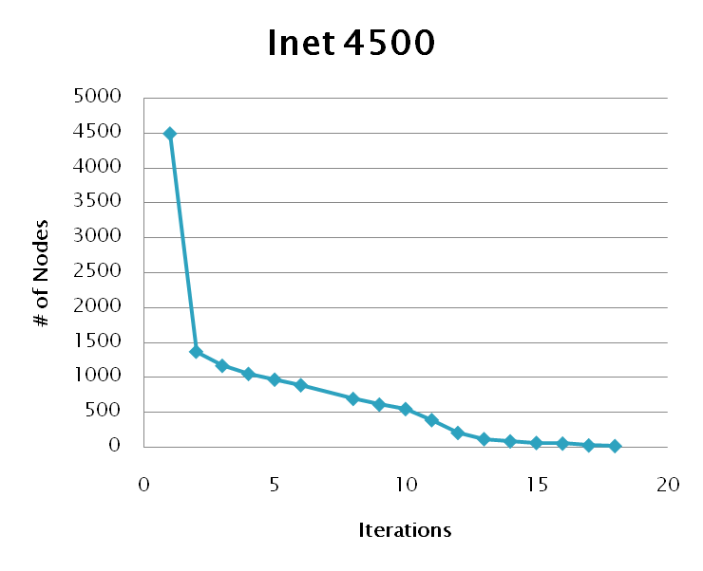
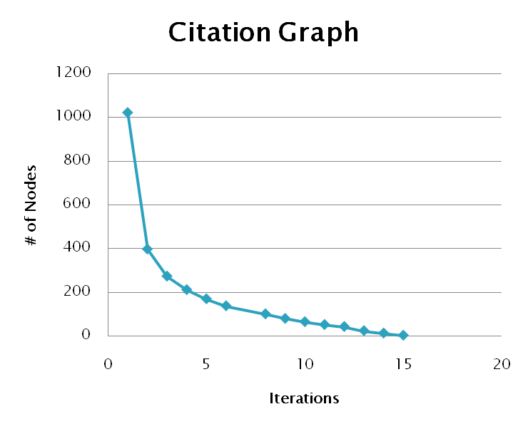
Shortest Paths
Notes:
31

Slide 32
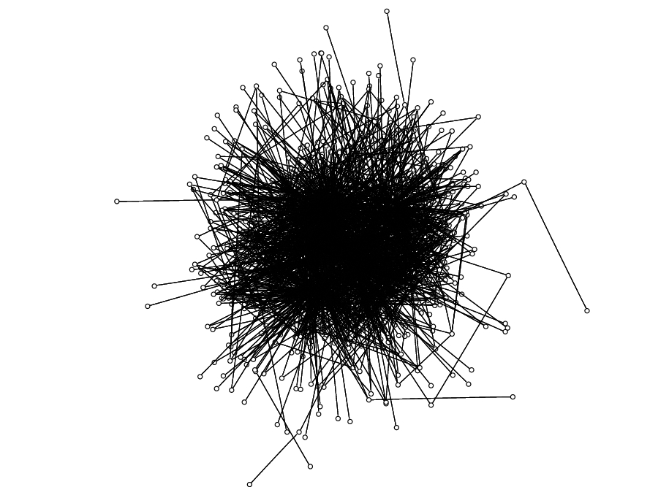
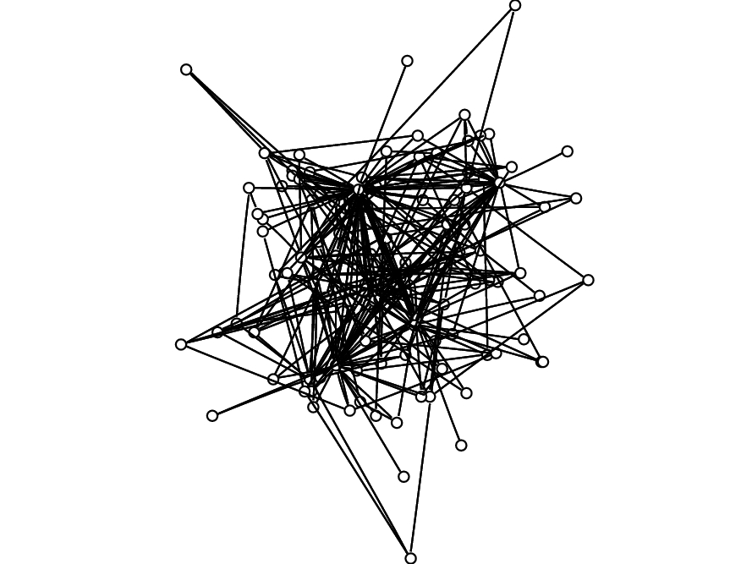
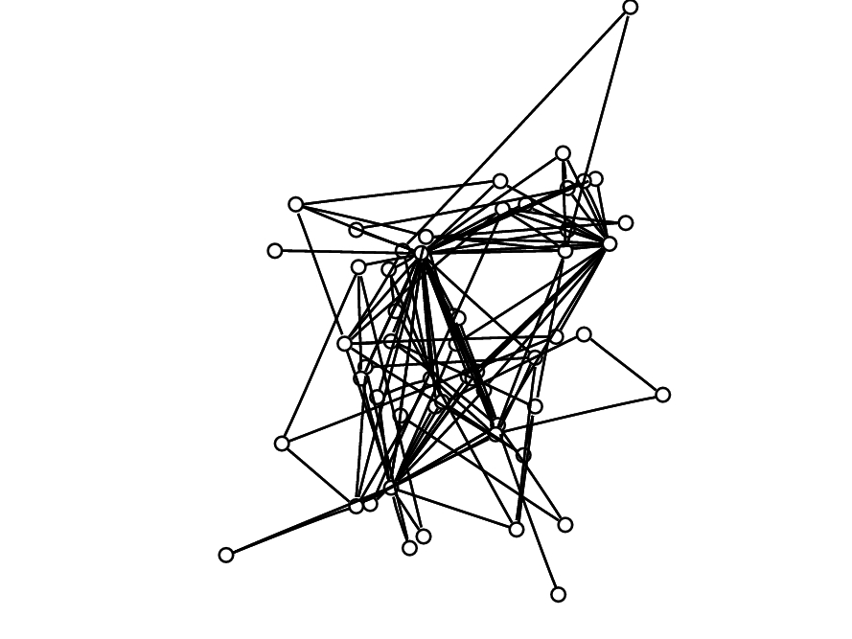
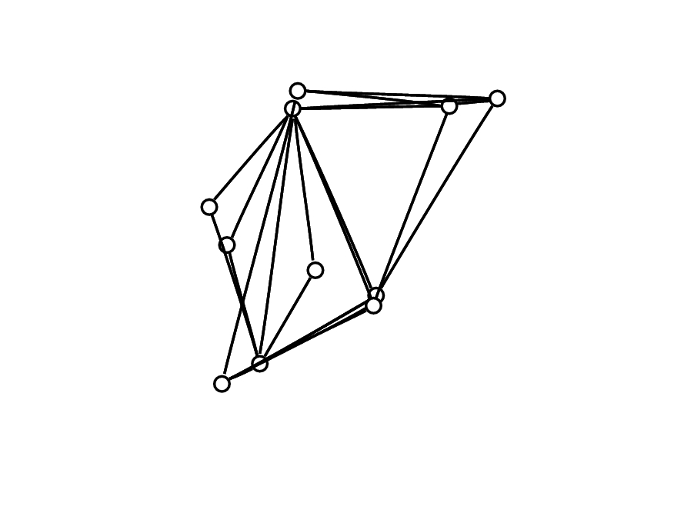
Inet Graph: # Shortest Paths
T = 1000
T = 40000
T = 100000
T = 645000
Notes:
32

Slide 33
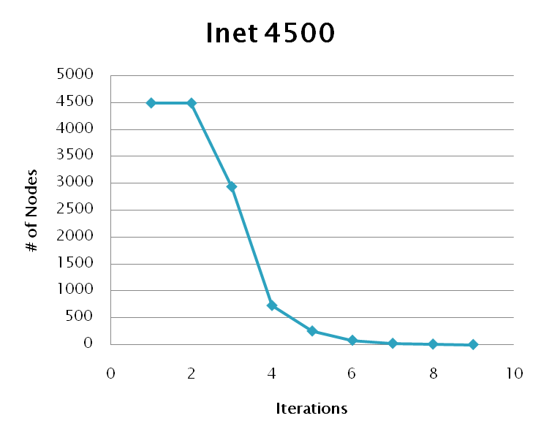
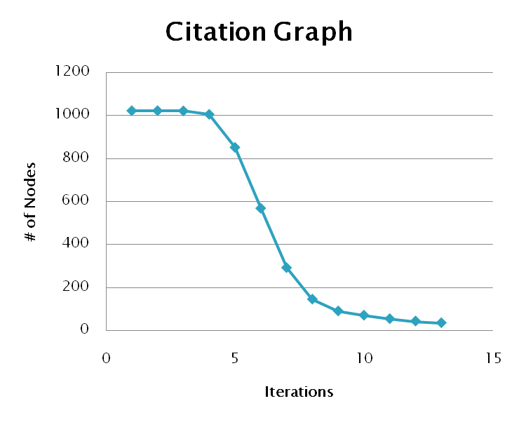
Eccentricity
Notes:
33

Slide 34
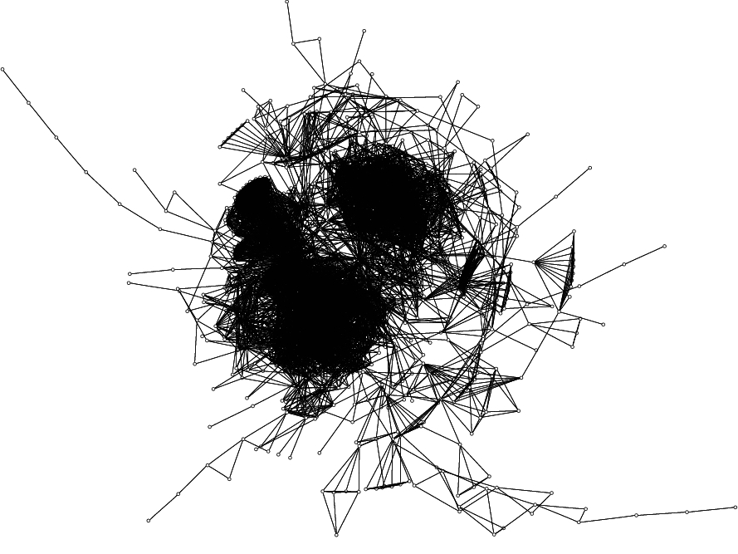
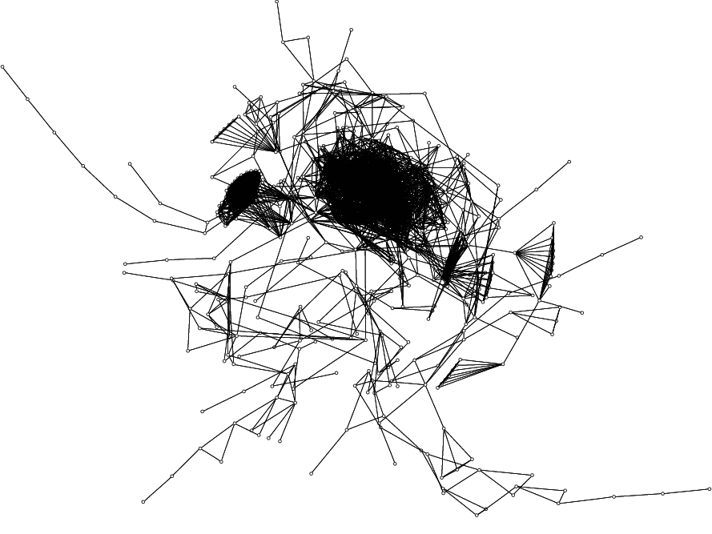
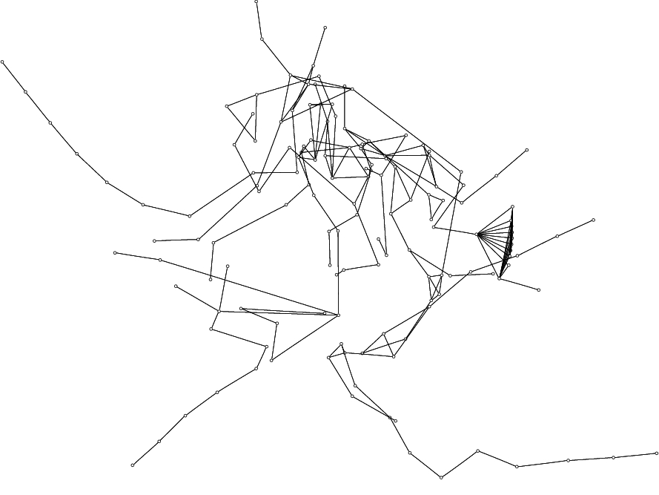
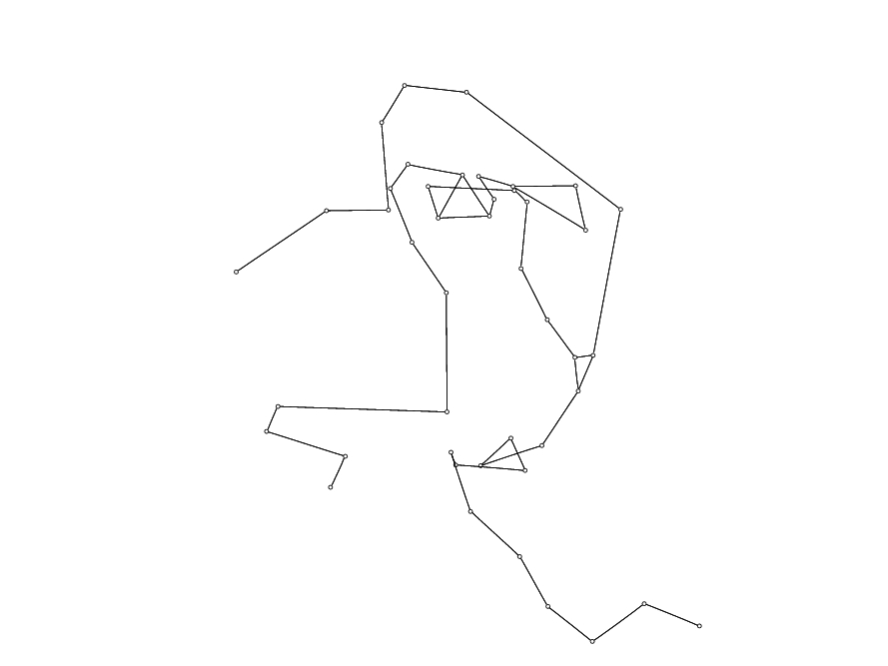
Citation Graph: Eccentricity
T = 10
T = 13
34
T = 15
T = 19
Notes:
34

Slide 35
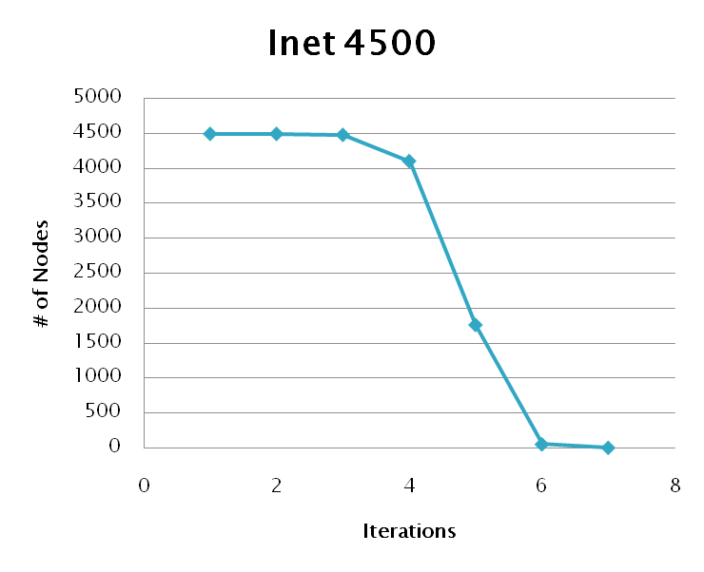
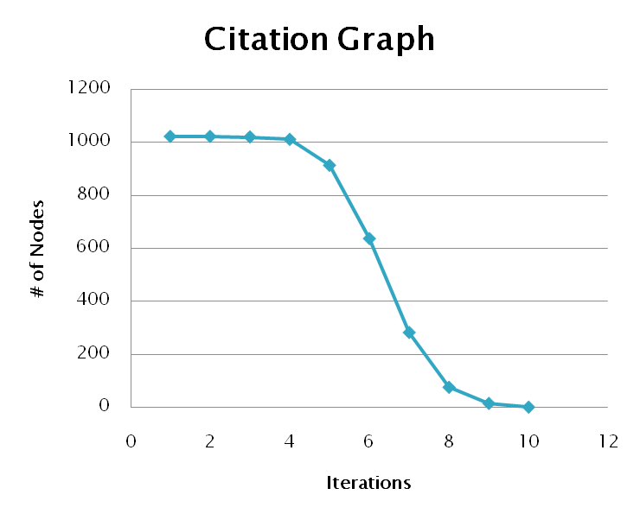
Shortest Distance to a Center Node
Notes:
35

Slide 36
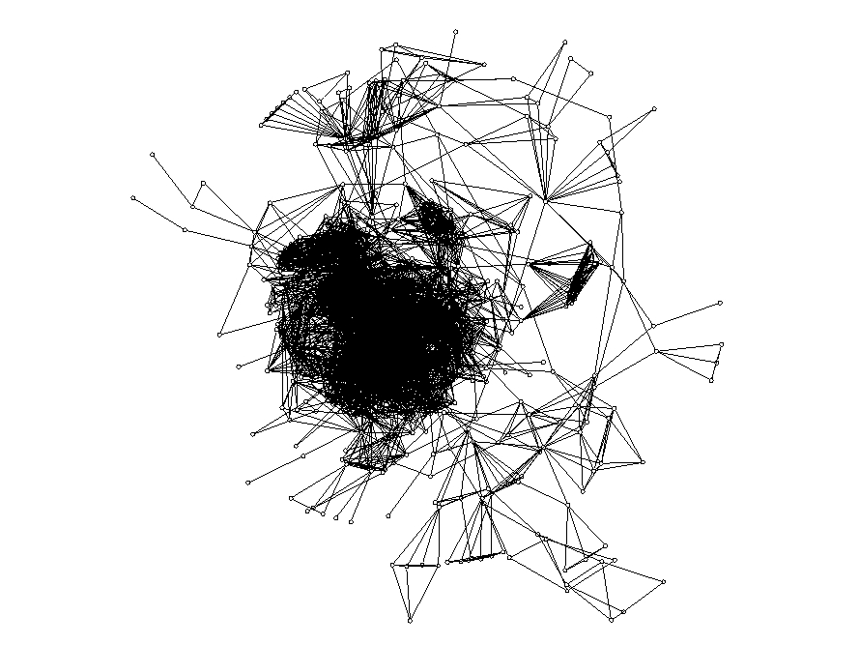
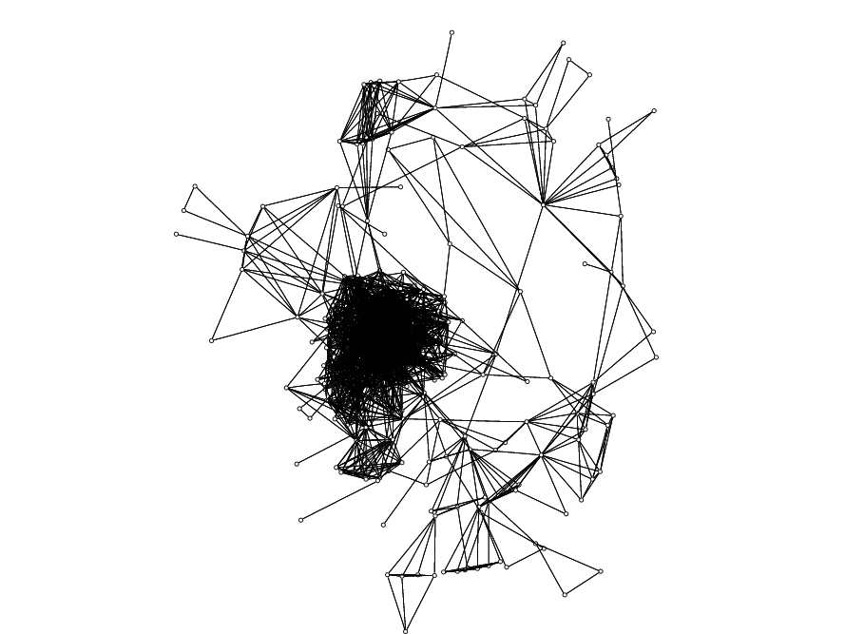
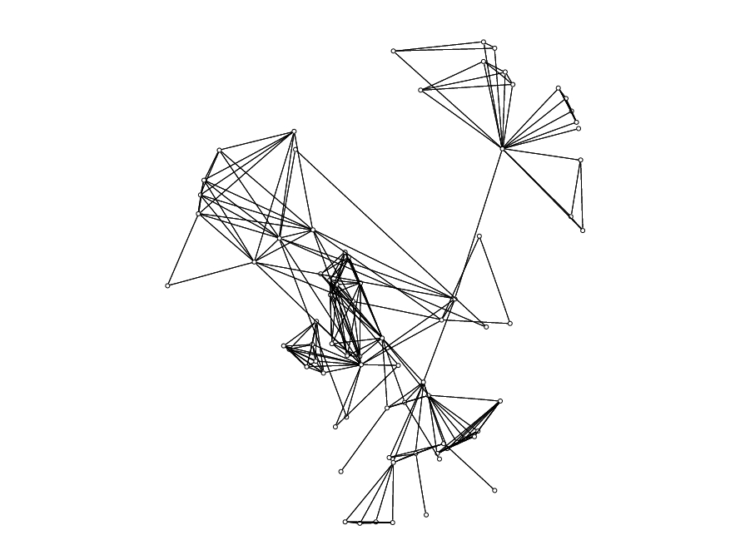
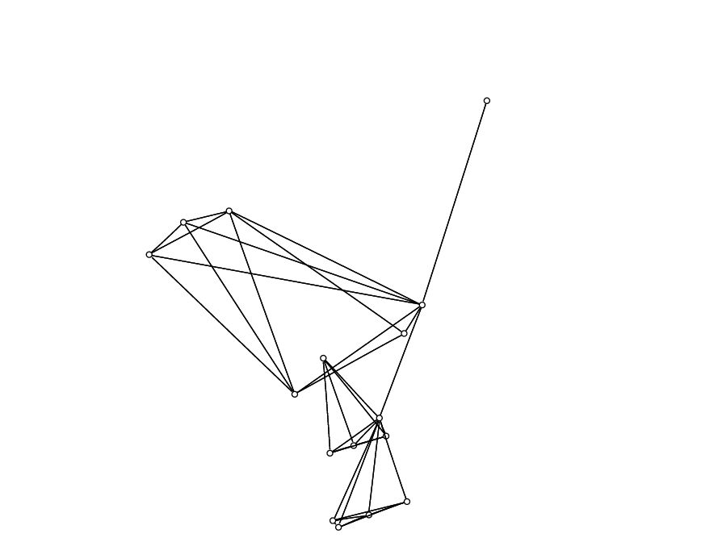
Citation Graph: Shortest Distance to a Center Node
T = 5
T = 6
T = 7
T = 8
Notes:
36

Slide 37
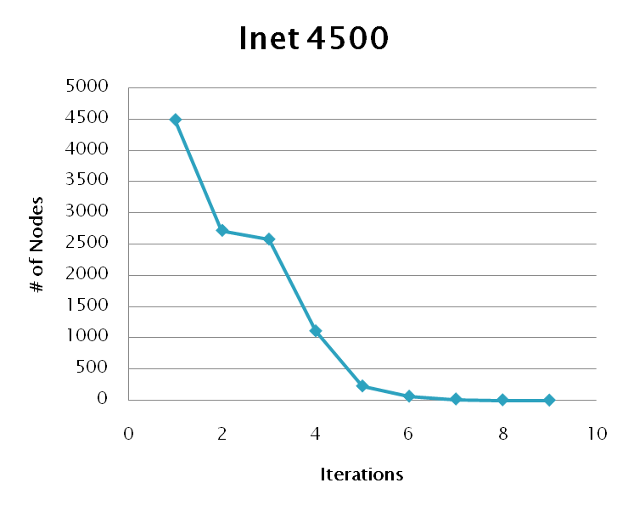
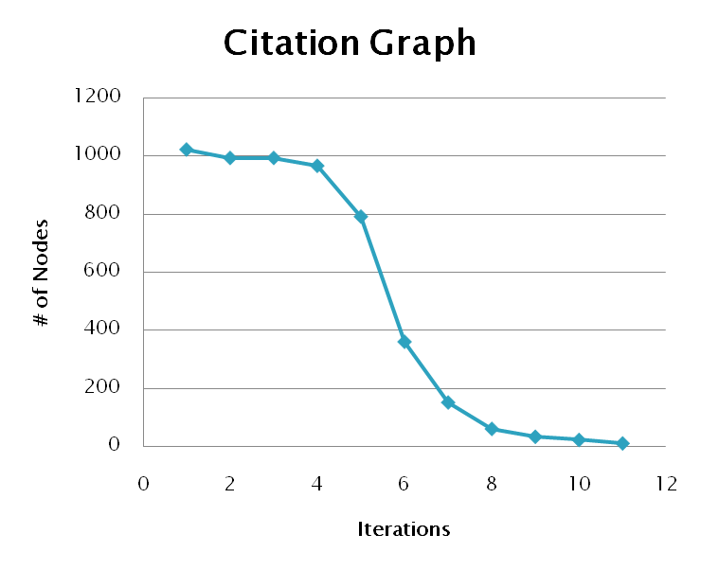
Shortest Distance to a Leaf Node
Notes:
37

Slide 38
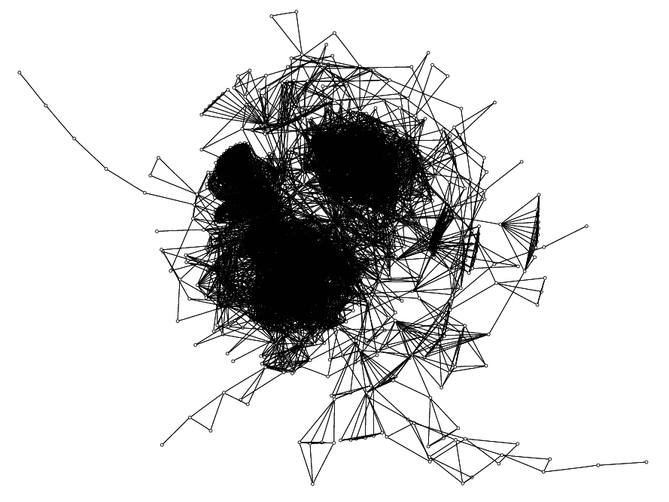
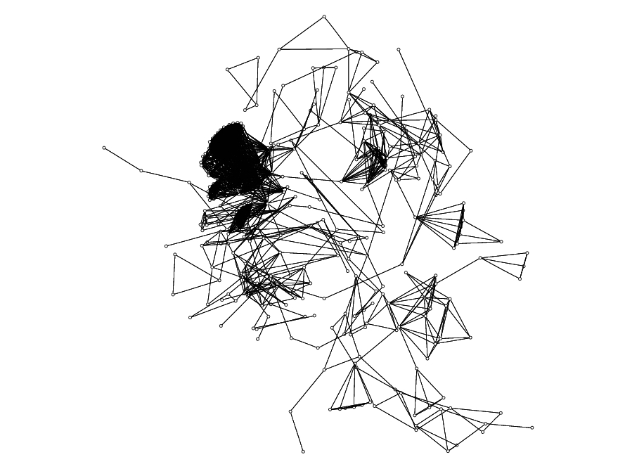
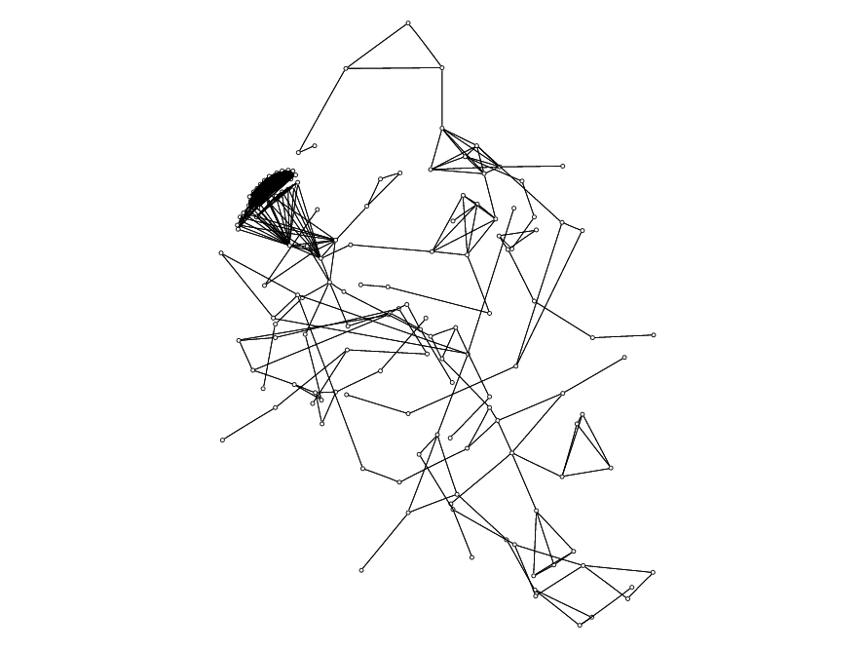
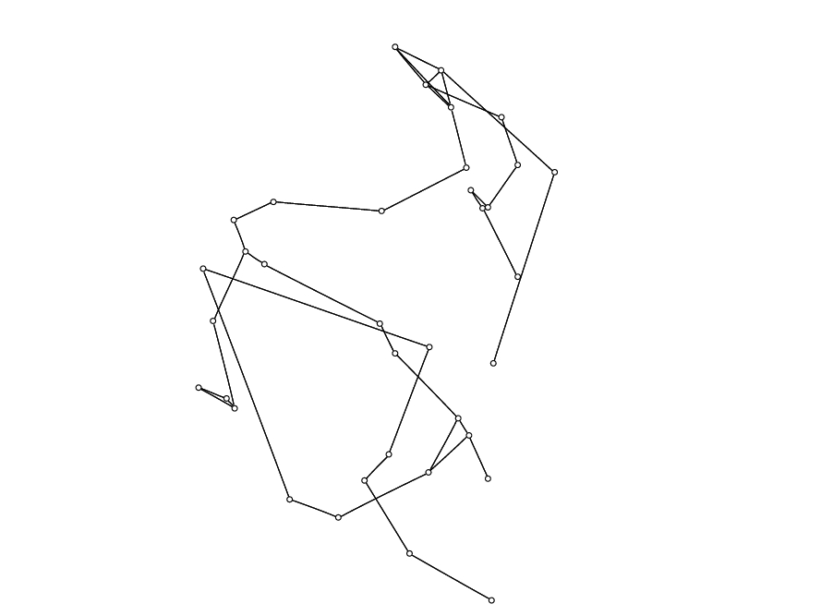
Citation Graph: Shortest Distance to a Leaf Node
T = 2
T = 5
T = 6
T = 9
Notes:
38

Slide 39
Conclusion
Proposed Method
Shown several weighting metrics
Evaluated performance
Applied metrics to several graphs
Future Work
Define further metrics
Consider more graph types
Notes:
39

Slide 40
GPU Based Algorithms for Spectrum Sensing in Cognitive Radio Networks
Chapter 3

Slide 41
Cognitive Networking & Spectrum Sensing
Spectrum sensing computational expensive
Performance improvement needed
Real world needs real time processing
Potential improvements
Distributed/collaborative algorithms
New more efficient algorithms
Advanced computing architectures

Slide 42
Why use the GPU?
GPU Architecture built for data parallelism
Thousands of threads
Fast complex computation
High precision supported

Slide 43
Why use the GPU?
GPU Architecture built for data parallelism
Thousands of threads
Fast complex computation
High precision supported
High speed computation
Availability & cost effectiveness

Slide 44
Application to Cognitive Networking

Slide 45
Energy Detection
Detects weak, deterministic signals in AWG noise
Energy detectors required to be suboptimal
Optimal detectors require matched filters
Requires a priori knowledge of data
Suboptimal detectors include
Low-pass filter and square law detector
Periodogram based detector

Slide 46
Energy Detection Periodogram Based Detection
Welch method of averaged periodograms
Creates M segments with D overlap
Hamming window applied to each segment
Periodogram of each segment is computed
All segments are averaged together
Estimates the PSD function
Con: Reduces the resolution of the resulting signal down to size M

Slide 47
Cyclostationary Spectral Analysis
Detects low SNR modulated signals
Distinguishes between
Modulated signals
Interference
Noise
Estimates correlation between spectral components of the signal.
Described by the SCD function.

Slide 48
FFT Accumulation Method
3 Steps to the algorithm
Compute Complex Demodulates (Eq 2)
Compute Product sequences (Eq 1)
Reorder data into cycle frequency vs. frequency
Estimates the SCD function
(Eq 1) SCD Function
(Eq 2) Complex Demodulates

Slide 49
Algorithm Implementations: CPU vs GPU
Algorithms first developed in Matlab R2008a
Efficient tool for complex calculations
Matlab based multi-threading
NVidia CUDA used for GPU
Well defined GPU platform
Exposed to software developers

Slide 50
Energy Detection Results
Matlab Timings (msec)
M | 512 | 1024 | 2048 | 4096
25% Overlap | 15.987 | 10.196 | 11.523 | 8.656
50% Overlap | 22.818 | 14.17 | 26.37 | 10.817
75% Overlap | 42.717 | 25.284 | 26.428 | 17.409
CUDA Timings (msec)
M | 512 | 1024 | 2048 | 4096
25% Overlap | 1.49 | 1.494 | 1.543 | 1.69
50% Overlap | 1.465 | 1.459 | 1.527 | 1.693
75% Overlap | 1.457 | 1.462 | 1.555 | 1.72

Slide 51
FFT Accumulation Method Results
Matlab Timings (msec)
N | 1024 | 2048 | 4096 | 8192
Channelize | 0.253 | 1.312 | 1.366 | 1.133
Window | 1.042 | 1.577 | 4.433 | 13.533
Np-point FFTs | 0.493 | 0.903 | 1.333 | 2.233
Down Convert | 2.370 | 4.777 | 10.066 | 17.4
Product Seq | 9.876 | 41.413 | 166 | 658.5
P-point FFTs | 13.848 | 54.107 | 222.3 | 882.566
SCD | 41.45 | 177.039 | 780.566 | 3144.133
Total | 69.432 | 280.899 | 1186.133 | 4719.567

Slide 52
FFT Accumulation Method Results
CUDA Timings (msec)
N | 1024 | 2048 | 4096 | 8192
Mem Transfer | 0.564 | 0.544 | 0.537 | 0.58
Channelize | 1.127 | 0.569 | 0.765 | 0.732
Window | 0.51 | 0.404 | 1.238 | 3.343
Np-point FFTs | 0.49 | 0.284 | 0.591 | 0.672
Down Convert | 0.671 | 0.382 | 0.777 | 0.841
Product Seq | 1.475 | 4.067 | 14.992 | 56.338
P-point FFTs | 1.327 | 3.537 | 13.886 | 52.331
SCD | 0.826 | 1.386 | 6.19 | 34.603
Total | 6.993 | 11.179 | 38.98 | 149.445

Slide 53
Conclusion
Ported two algorithms to the GPU
Periodogram based Energy Detector
FFT Accumulation Method
GPU greatly increases performance
Up to 30x speed up
Even with memory transfers
Future Work
Further optimization of GPU code
Explore other algorithms

Slide 54
Final Conclusions
Presented algorithms for visualization and simulation
MANET visualization
Visualizing complex graphs
GPU based cognitive network simulation
Showed their benefits and applications
Provided ideas for future research

Slide 55
Acknowledgements
Alex Fridman of Drexel University’s ECE Department for OMAN research support.
Dr. Chaomei Chen of Drexel University’s iSchool for providing the citation graph data set.
Boris Shishkin of Drexel University’s ECE Department for cognitive networking research support.
U.S Army Communications Electronic Research Development and Engineering Center (CERDEC) under contract # DAAB-07-01-9-L504

Slide 56
Questions?

